Slide 1
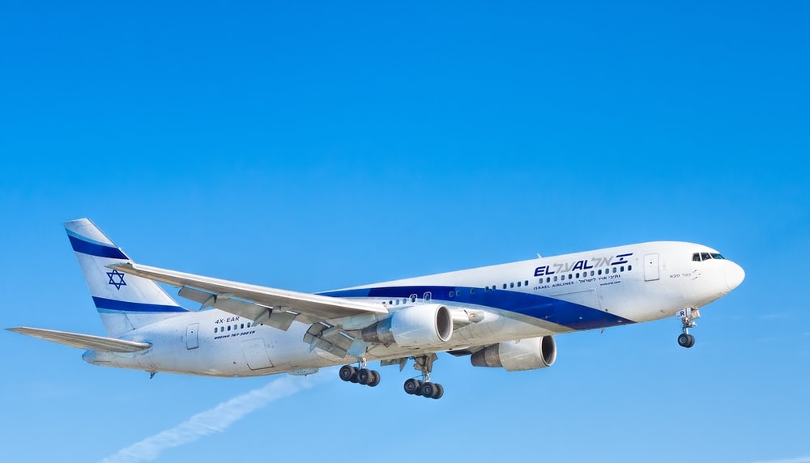
Airline Ticket reservation System

Slide 2
Content
Introduction
Primary Goals
Secondary Goal
Target Segments
Features
Requirements

Slide 3
INTRODUCTION
Airline reservation System is a computerized system
Enhancing the relationship between customers and airline agencies
Convenient for the customers to book the flights
Allow the customers to access database and allow new customers to sign up for online access

Slide 4
PRIMARY GOALS
The primary goal of this project is to help the passengers make flight reservation.
The system will be able to find all the flights fulfilling a passenger’s needs.
search all flights with a given origin and destination.
The arrival and departure times, the price, and the flight number for each flight.
The passenger will decide the flight reservation based on the displayed information.

Slide 5
Secondary Goal
The secondary goal is to provide a means for the airline manager to manage the flights.
The airline manager will be able to schedule new flights, drop flights from the schedule and change the fare for a flight.
Manager will also have clearer and better view about the flight schedule.
The manager can decide to add flights if there are high demand of reservation at a certain time

Slide 6
Target Segments/Module
Administrator Module.
Register Module .
Passenger Module.
Cancellation.

Slide 7
Administrator Module.
It is provided for the sake of administrators to manage the site and update the content at regular intervals, The major operations included in this module are:
Create and maintain airline schedule, fare and timings of the Flight.
View the passenger list.
View the available seats in the flights.
Cancel the tickets.
Updating the flight schedule and timings and fare

Slide 8
Registration Module
Firstly we ask passenger to give his details .
After registering the passenger can logon to his/her own account and book his flight.
Once Passenger registered with us can book any number of tickets

Slide 9

Passenger Module.
It is meant for passengers, where a user logging into his/her owns account will view this panel. The major operations included in this module :
View all airline schedules, timings, fare details and seats availability.
Book for the tickets.
View and cancelling of the ticket.
Send feedback.

Slide 10
Cancellation.
Registered user can cancel his/her reservation by giving valid email address and password and mention the reasons for cancellation.

Slide 11
FEATURES
Providing flight details
Flight bookings for a particular destination,
Date and time and also providing with a pin code.
Allowing the customer to modify or cancel his reservation provided the correct pin code is given.
Displaying a report of the number of people flying in a particular flight

Slide 12
Hardware & Software Requirements
▪ Hardware Requirements:-
Processor-Pentium III @500 MHz or above RAM-256 MB Hard Disk-40 GB
Software Requirements:-
Operating system-windows 2010 or above
Front End-HTML,PHP,CSS,JAVASCRIPT
Back End- MySQL Server

Slide 13
APPLICATIONS
No geographical barriers; user can book tickets from any location.
User-friendly graphical Interface helps to book tickets.
Cancellations from anywhere to any place
More sale of tickets brings more profits

Slide 14
Limitations
Currently we are not able to introduce mobile verification system.
Currently we are not able to add online payment system.

Slide 15
Future Works
Develop mobile app of this system.
Add mobile verification system.
Introduce live chat between admin & user.

Slide 16
Conclusion
Air reservation system, which enable customer to check the availability tickets & book their tickets .
It makes the customer easy to get ticket online instead of queue up to buy the tickets.

Slide 17
THANKU

